Slide 1


Bank Credit Risk Analysis With Bayesian Network Decision Tool
Abhishek Sharma
Aishwarya Mandava
Piyush Chopra
Suruchi J. Ahuja

Slide 2
Introduction
Bank credit risk analysis is widely used at all banks all around the world. Credit risk analysis is very critical tedious process, and a variety of techniques is used for risk level calculation.
Credit risk is one of the main functions of the banking community . Banks classify customers according to their profile. Credit risk level can be estimated using a credit scoring system – this method involves scoring customers by using predetermined criteria.
There are subjective factors and objective factors too which depend on bank decision strategy and its mission. Credit scoring system is used to measure both the factors.

Slide 3
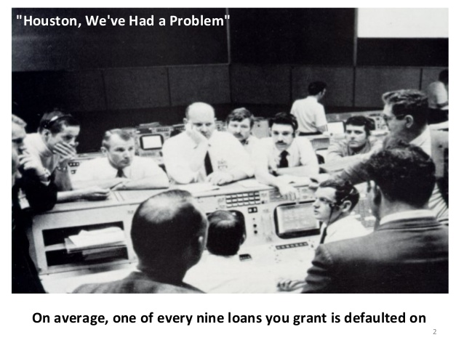
Importance of Risk analysis.
Effective risk management strategies allow you to identify your bank’s strengths, weaknesses, opportunities and threats. By planning for unexpected events, you can be ready to respond if they arise.
To ensure your Bank’s success, define how you will handle potential risks so you can identify, mitigate or avoid problems when you need to do.
The definitions of risk modelling include
· The magnitude of loss from an unexpected event.
· The probability that “things won’t go right”.
· The effect of an adverse outcome.
. The likelihood and undesirable event will occur.

Slide 4
These risks are inter-dependent and events affecting one area of risk can have ramifications and penetrations for a range of other categories of risks.
Foremost thing is to understand the risks run by the bank and to ensure that the risks are properly confronted, effectively controlled and rightly managed.
Each transaction that the bank undertakes changes the risk profile of the bank.
The extent of calculations that need to be performed to understand the impact of each such risk on the transactions of the bank makes it nearly impossible to continuously update the risk calculations.
Hence, providing real time risk information is one of the key challenges of risk management exercise.

Slide 5
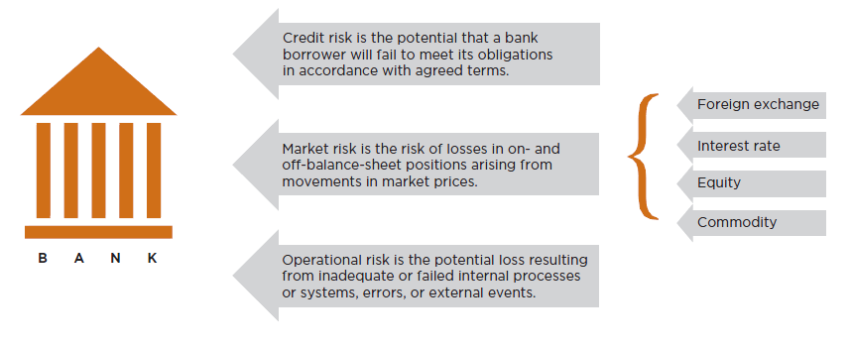
Source: Global Association of Risk Professionals (GARP)

Slide 6
Understanding credit Risk
Credit risk consists of primarily two components, viz Quantity of risk, which is nothing but the outstanding loan balance as on the date of default and the quality of risk, viz, the severity of loss defined by both Probability of Default as reduced by the recoveries that could be made in the event of default. Thus credit risk is a combined outcome of Default Risk and Exposure Risk

Slide 7

The German Credit Dataset

Slide 8
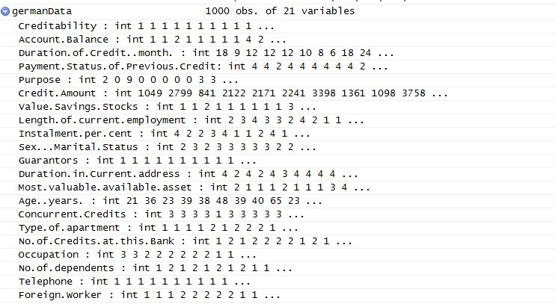

Slide 9
The German Credit Data - 20 variables
Classification as applicant is Good or a Bad credit risk
1000 loan applicants.
Historical pre-loan data
Two types of risks are associated with the bank’s decision for a loan approval are
Type-I risk : If the applicant is a good credit risk, i.e. is likely to repay the loan, then not approving the loan to the person results in a loss of business to the bank
Type-II risk : If the applicant is a bad credit risk, i.e. is not likely to repay the loan, then approving the loan to the person results in a financial loss to the bank
Data available at UCI machine learning data repository
http://www.ics.uci.edu/~mlearn/MLRepository.html
and on 747 web page
http://www.stat.auckland.ac.nz/~reilly/credit-g.arff

Slide 10
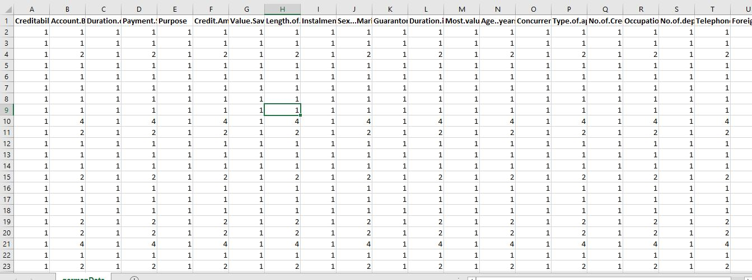
Snapshot of the Data set

Slide 11
Main aim of the project :
New applicants for credit can also be evaluated on these 20 "predictor" variables. We want to develop a credit scoring rule that can be used to determine if a new applicant is a good credit risk or a bad credit risk, based on values for one or more of the predictor variables.
Developing of general techniques to model bank credit risk analysis.
Developing a simple design for a Bayesian network nodes and a simple algorithm for the calculation of probability of conditional tables.
To compare the approaches of various Bayesian network models
General discussion about the advantages of Probabilistic Graphical Models

Slide 12
Bayesian Network
Bayesian Networks - graphical model representing the complete probability distribution and the independencies involved as directed graphs.
It is a very strong decision tool
Capable of doing inferences even when noisy and incomplete data are available.
Representation of both quantitative and qualitative knowledge.
In the bank credit risk analysis, both objective and subjective factors are available. Bayesian Networks consists of nodes and directed links. Each node represents a random variable or events.
Directed links show the cause – effect relation between nodes. Each node has conditional probability tables.
The graph has no directed cycles. This means there is no feedback between nodes. Thus the direction of links is important.

Slide 13
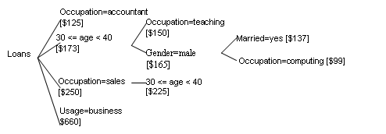
Source of Idea

Slide 14
Learning of Bayes Net
Four categories of learning problems
Graph structure may be known/ unknown
Variable values may be fully observed / partly observed.
In our case, The data is fully observed and the graph structure is unknown. Hence we move forward to learning those methods which involve such a case.

Slide 15
Total Methods considered.
Naïve bayes
Tree Augmented Mentods:
Backward sequential elimination and joining (BSEJ)
Forward Sequential Selection and Joining(FSSJ)
Hill-Climbing
Hill-climbing super-parent naive Bayes
Chow-Liu’s algorithm for one-dependence estimators
Hill-climbing score-based
Handcrafted Domain Network

Slide 16
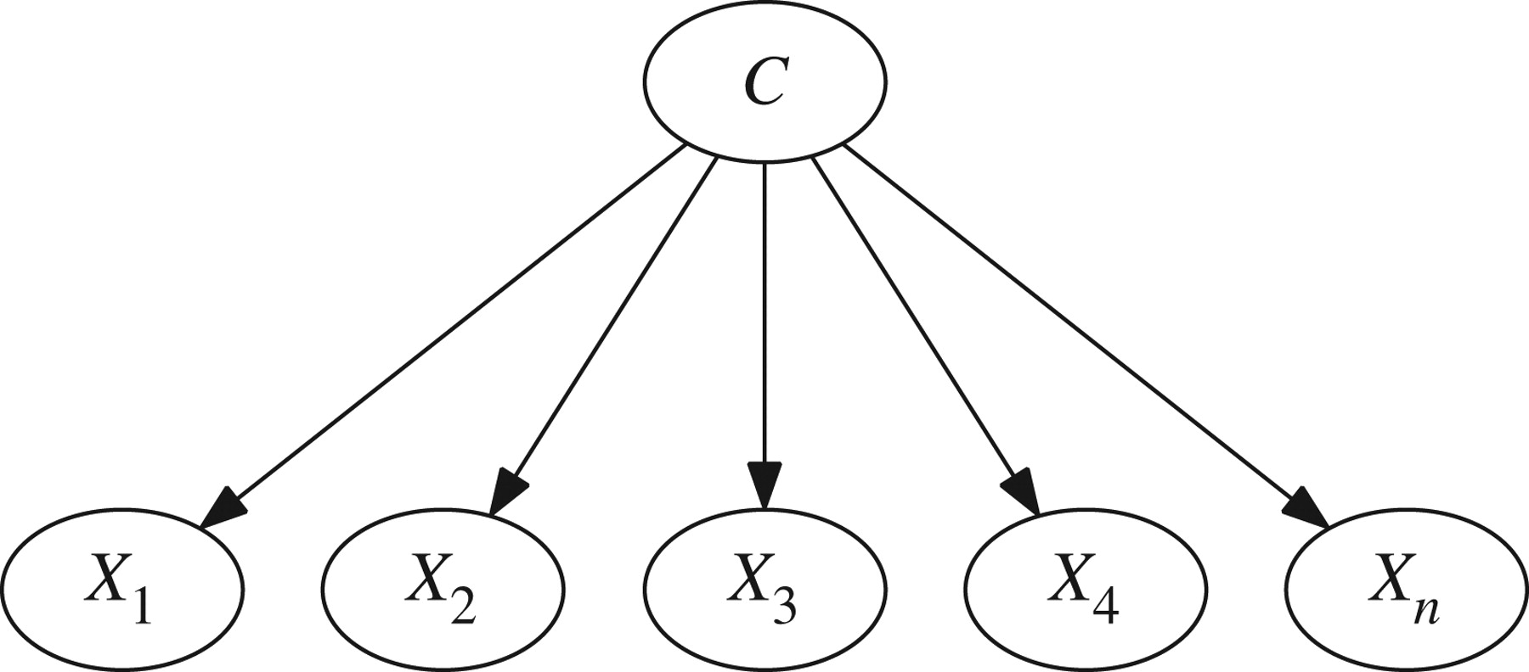
Naïve Bayes

Slide 17
Naïve Bayes
Naive Bayes classifiers - applying Bayes’ theorem with strong (naive)independence assumptions between the features.
Naive Bayes classifiers are highly scalable, requiring a number of parameters linear in the number of variables (features/predictors) in a learning problem.
Maximum-likelihood training can be done by evaluating a closed-form expression, which takes linear time, rather than by expensive iterative approximation as used for many other types of classifiers.
Naive Bayes and Tree Augmented Naive Bayes (TAN) are probabilistic graphical models used for modeling huge datasets involving lots of uncertainties among its various interdependent feature sets.

Slide 18
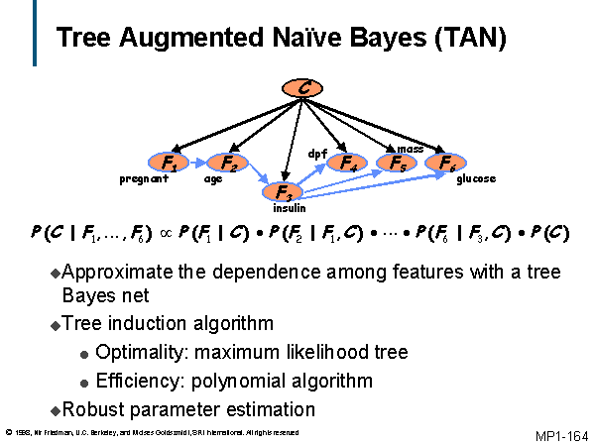

Slide 19
Tree Augmented Naïve Bayes
The TAN model improves on the Naive Bayes model by adding one more level of interaction among attributes of the system.
Every attribute is dependent on its class and one other attribute from the feature set.
Since this model incorporates the dependencies among the attributes, it is more realistic than a Naive Bayes model.
The TAN model gives better performance results if there are correlations between the attributes but the performance is almost the same as that of Naive Bayes model, if there are not enough correlations between the attributes of the system.

Slide 20
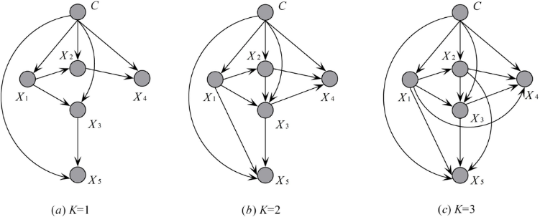

Slide 21
k-fold Cross-Validation
For smaller datasets, use k-fold cross-validation
Split dataset into k roughly equal parts
For each part, train on the other k-1 parts and use this part as the test dataset
Do this for each of the k parts, and average the resulting prediction errors
This method measures the prediction error when training the learner on a fraction (k-1)/k of the data
If k is small, this will overestimate the prediction error
k=10 is usually enough

Slide 22
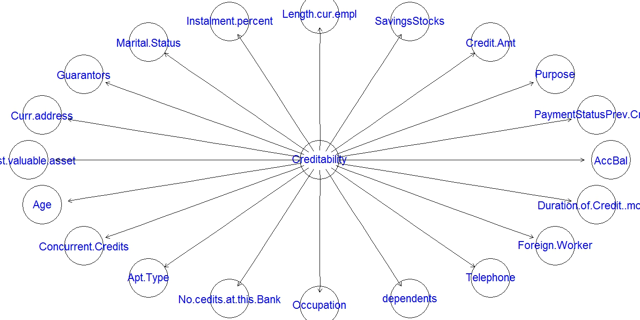
Naïve Bayes
Naïve Bayes

Slide 23
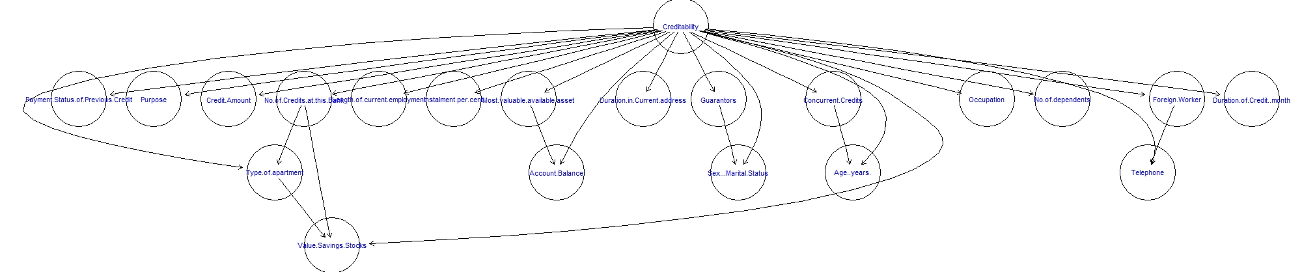
Backward sequential elimination and joining (BSEJ)

Slide 24
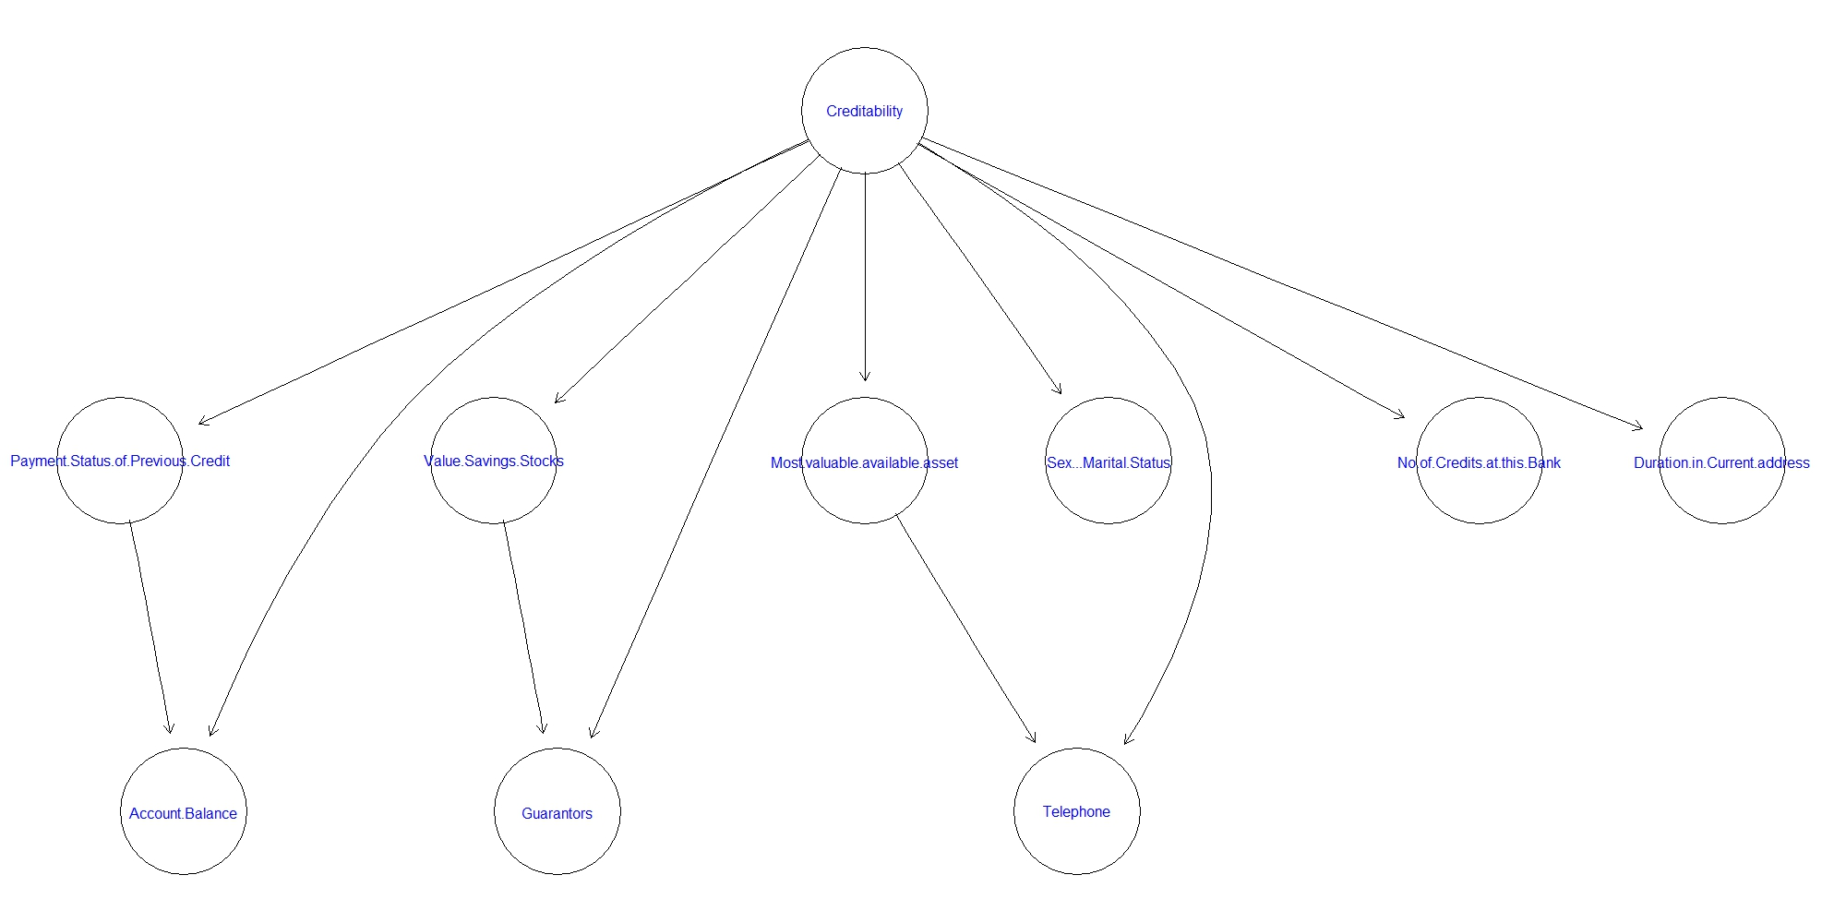
Forward sequential selection and joining (FSSJ)

Slide 25
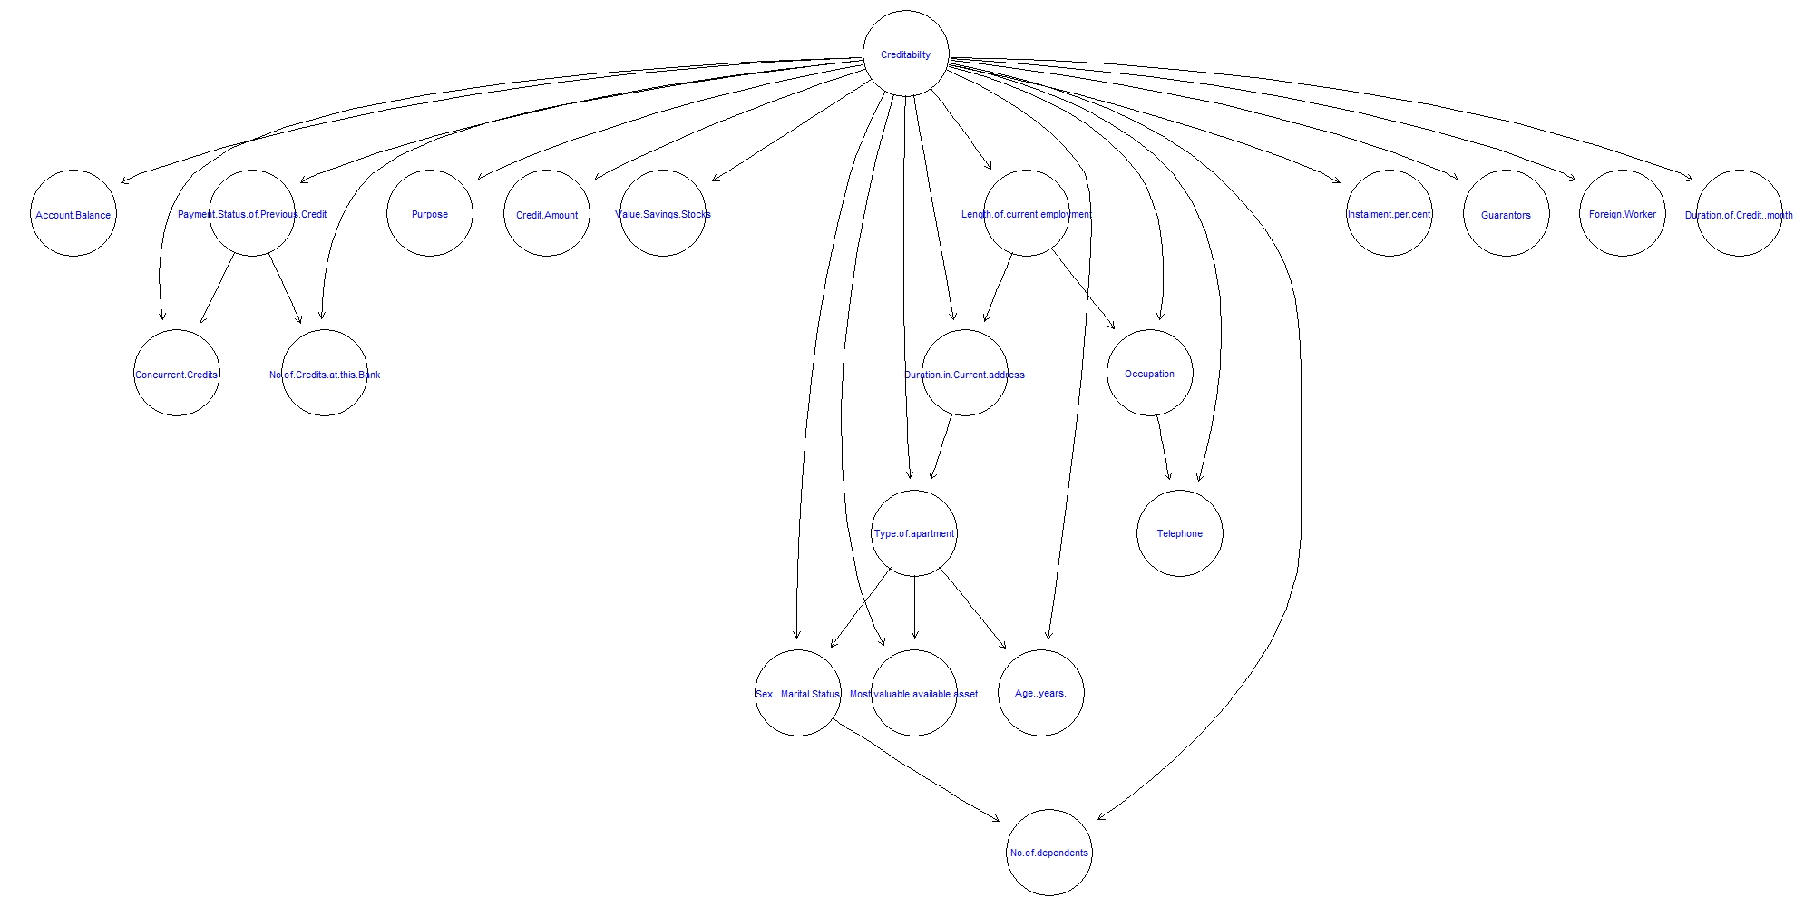
Chow-Liu’s algorithm for one-dependence estimators

Slide 26
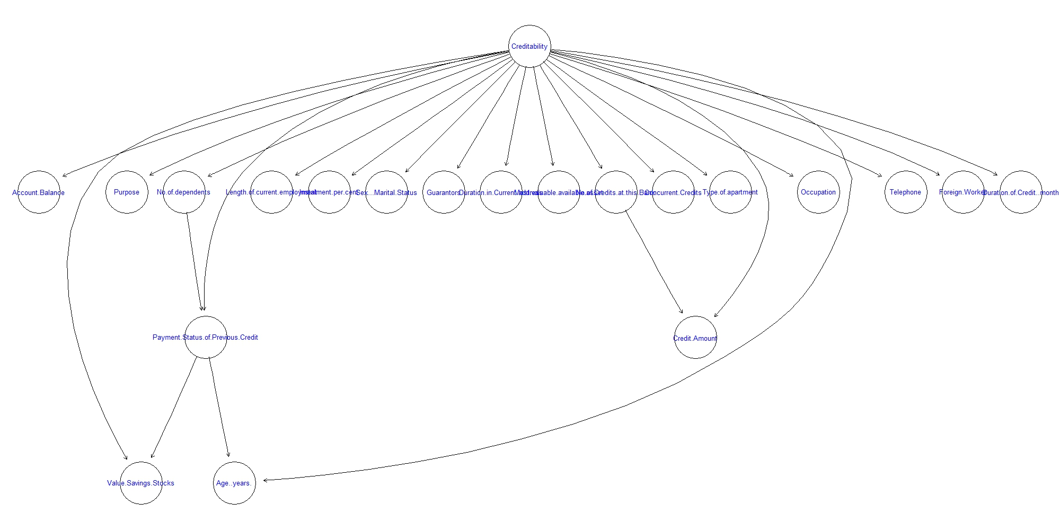
Hill-climbing tree augmented naive Bayes

Slide 27
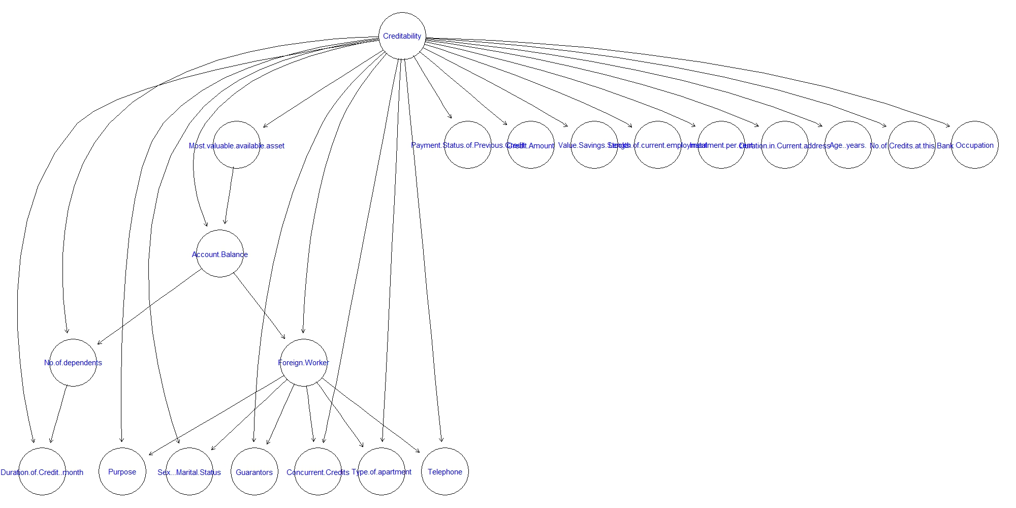
Hill-climbing super-parent tree augmented naive Bayes

Slide 28
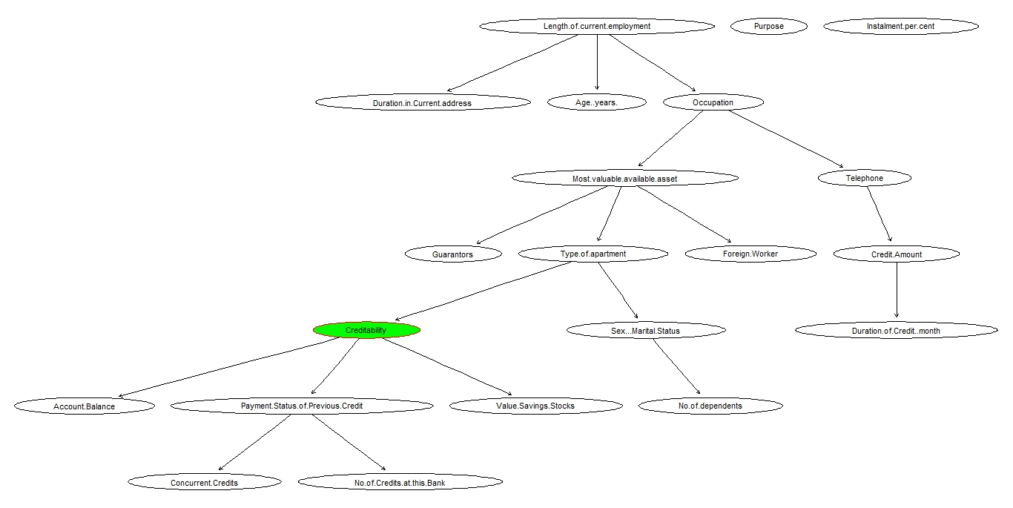
Hill-climbing score-based

Slide 29
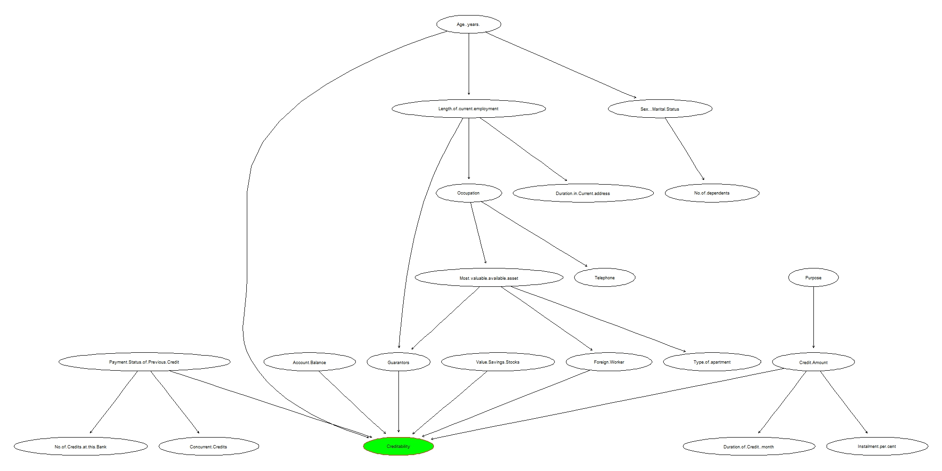
HandCrafted Network

Slide 30
Model Name
0.787
Chow-Liu’s
0.803
Hill-Climbin TAN
0.804
Hill-Climbing Super Parent- TAN
0.787
Forward sequential selection and joining (FSSJ)
Backward sequential elimination and joining (BSEJ)
0.789
Handcrafted Network
0.89
Accuracy
Naïve bayes
0.774

Slide 31
Types of Risk
Type-I risk : If the applicant is a good credit risk, i.e. is likely to repay the loan, then not approving the loan to the person results in a loss of business to the bank.
Ie. Labelling a good applicant as a bad applicant
Type-II risk : If the applicant is a bad credit risk, i.e. is not likely to repay the loan, then approving the loan to the person results in a financial loss to the bank.
Ie. Labelling a Bad applicant as a Good applicant

Slide 32
Penalty Matrix
1 = Good 2 = Bad | Predicted | Predicted Good | Predicted Bad
 | Penalties | 1 | 2
Actual Good | 1 | 0 | 1
Actual Bad | 2 | 5 | 0

Slide 33
Cost-Profit Calculations
 | TYPE-1 | TYPE-2 | TOTAL
TAN-CL | 27 | 39 | -222
TAN-HC | 26 | 39 | -222
TAN-HCSP | 28 | 42 | -236
FSSJ | 23 | 53 | -287
BSEJ | 26 | 41 | -229
Hand-crafted network | 16 | 18 | -106
Naïve Bayes | 29 | 42 | -239

Slide 34
Results
The model suggests that the following characteristic usually tend to show Higher risks
Lower balances in checking and savings
Have delinquent previous credit history
Have no guarantors
Have more than one Installment plans
Is a foreign Worker
Has a young age
Notes:
These are the results have to work on probing this .. Querying on our network

Slide 35
SCOPE AND FURTHER ANALYSIS
Prepare a cluster based Bayesian network wherein a set of features are grouped into a cluster and each cluster represents an additional node
This enables forming a Network where-in Similar features are grouped into a cluster and represent a generic characteristic of a Person eg. Features like age, sex, No.of Dependants are grouped into a cluster representing Personal info of a Person.
Determine CPT’s for this clusters which constitute latent nodes.
Another approach would be to form a score based network where-in the final credibility is determined based on the SUM of scores at individual stages.
Gain more Understanding based on expert knowledge.

Slide 36
Critical questions
Q1) What is the difference between Naïve Bayes and the Tree Augmented Naïve Bayes ?
Q2) How does the k- value affect the Chow-Liu algorithm ?
Q3) Suggest a method that can be used other than the ones used in the project.

Slide 37
Thank you!

